Slide 2
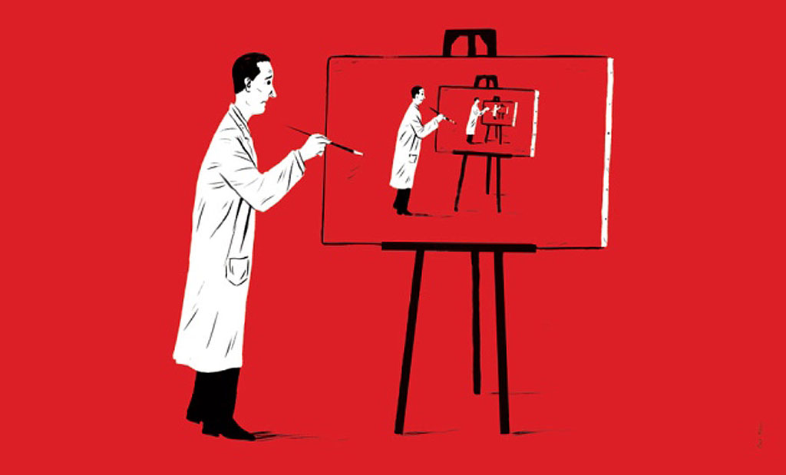
Congratulations! Your code is now reusable and your science reproducible!

Slide 3
Congratulations! Your code is now reusable and your science reproducible!
Appreciate what you achieved in one day

Slide 4

How was this for you? What questions do you still have? What do you take away?

Slide 5
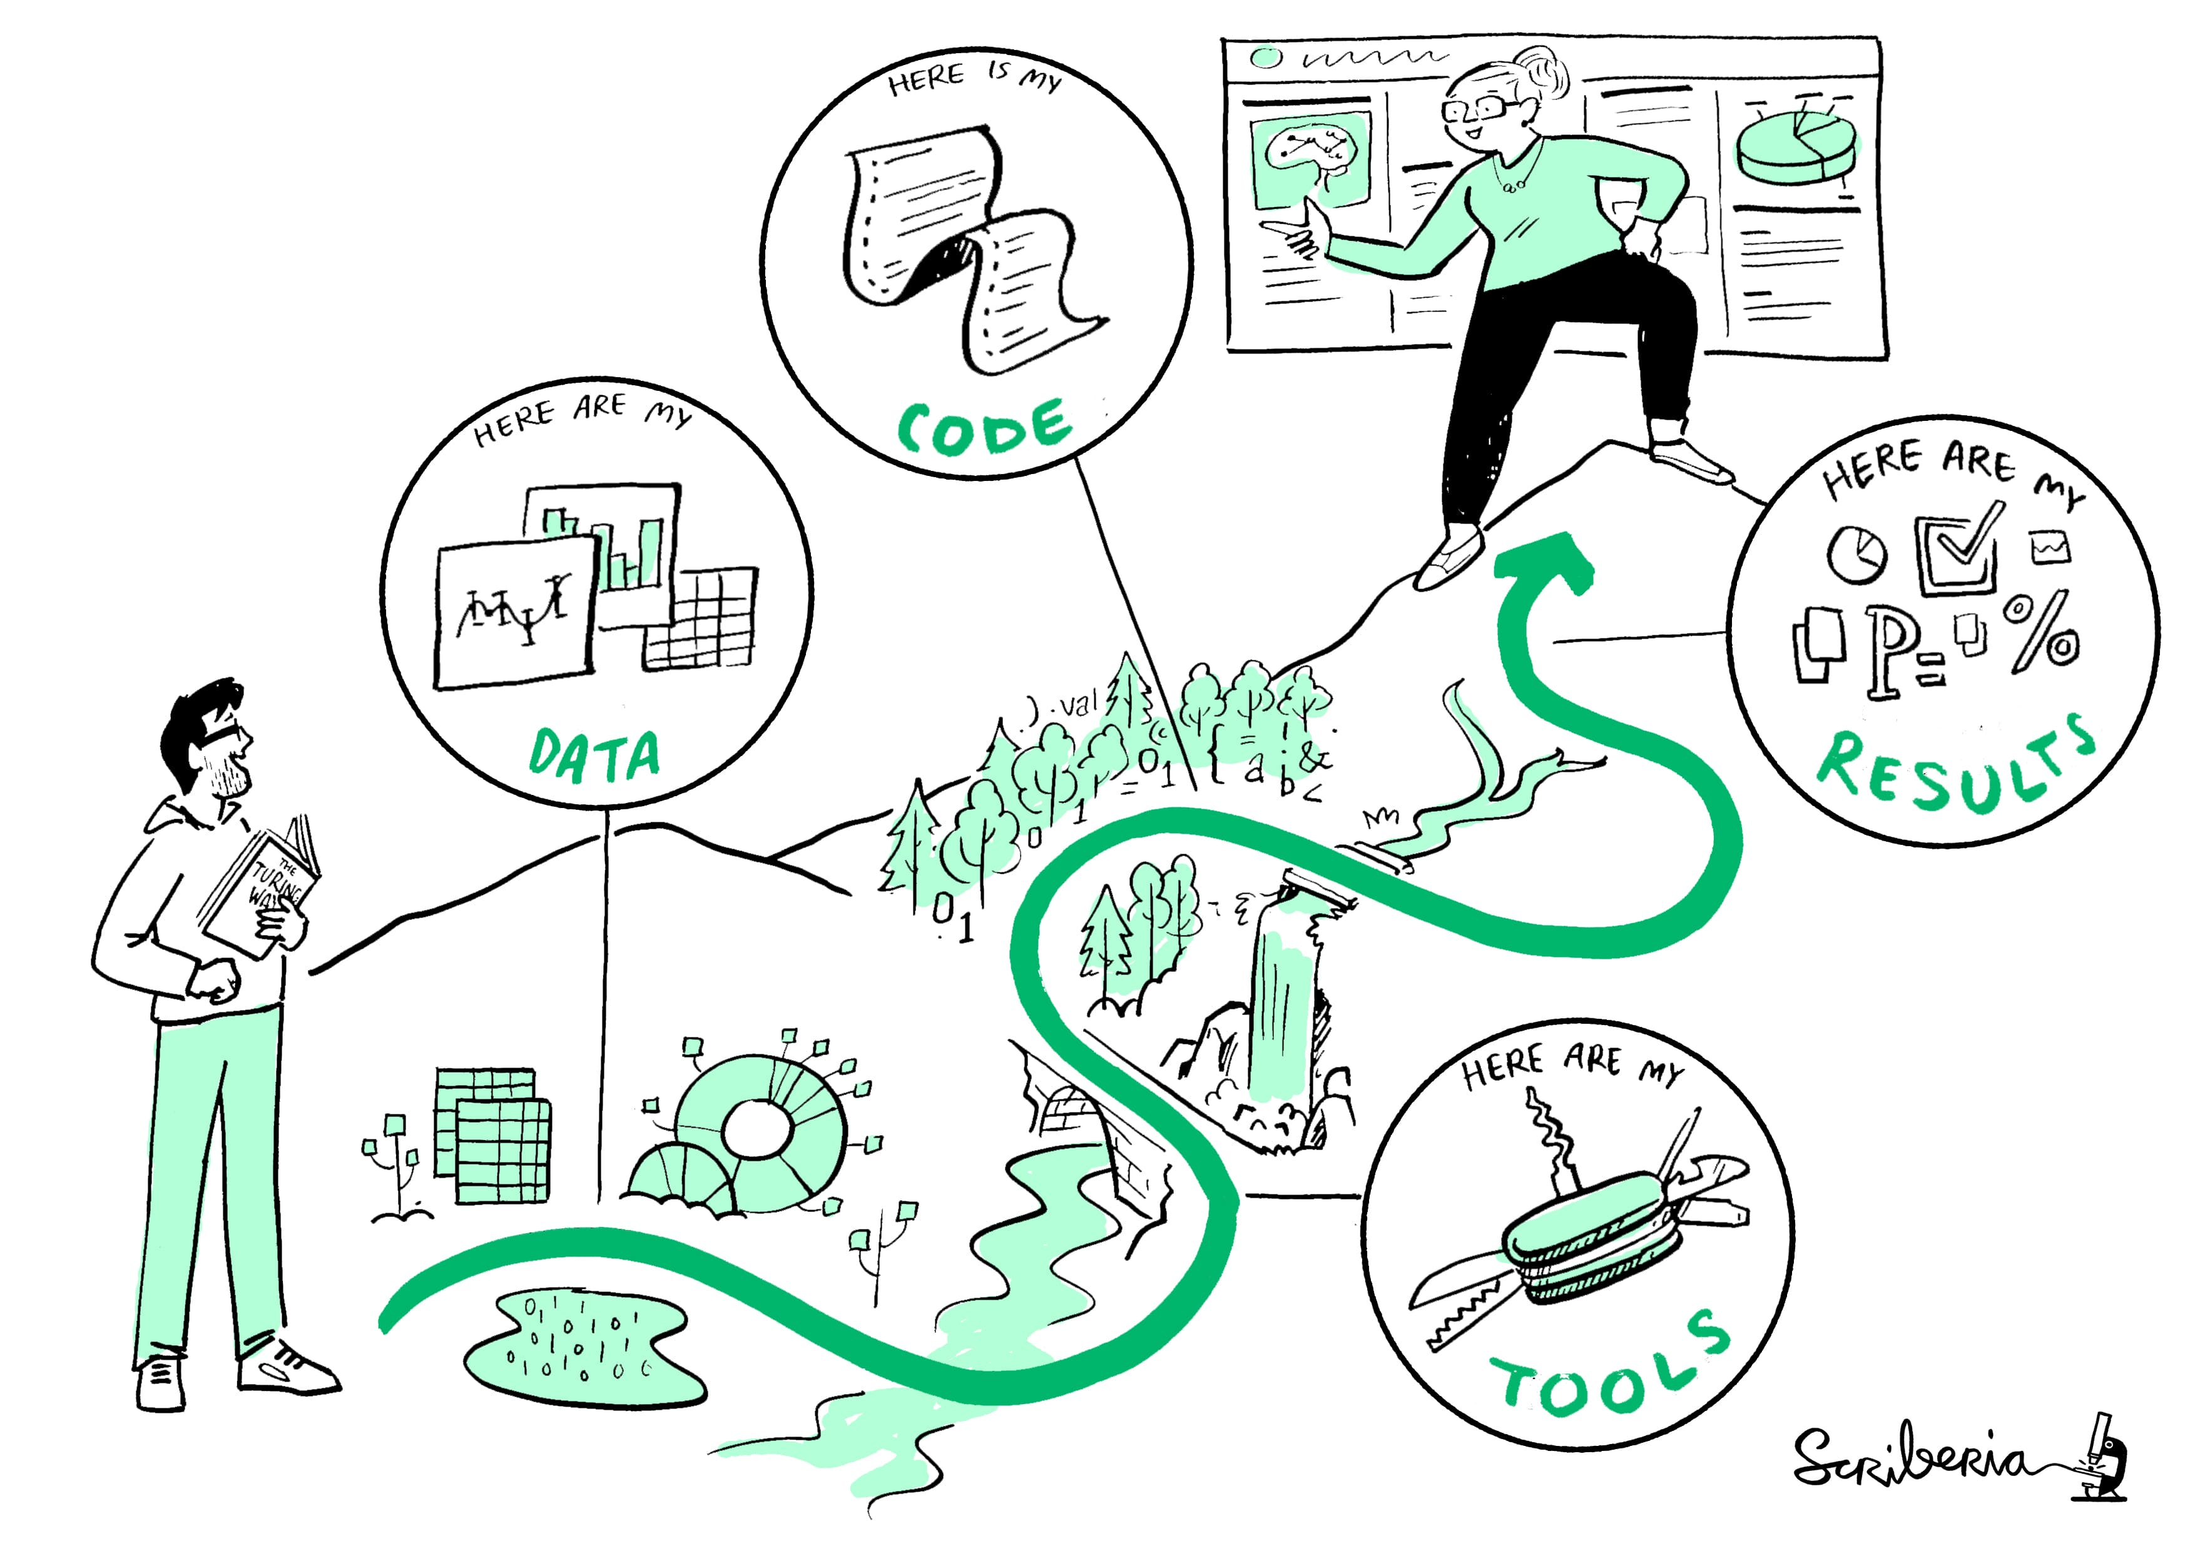
The minimum you need for reusable code:
Code on GitHub
A description of dependencies
A good README
Readable code
Shared data (if applicable)

Slide 6

Next steps
Improve reusablity of your project
Apply what you learned in other projects.
Self-learning (see collaborative documents for resources)
Read a book
Watch youtube
Online courses and tutorials

Slide 7
Spread the word!
Good science is reproducible science

